Slide 1

A quick start guide
To view, enable editing, select Slide Show, select From Beginning

Slide 2

From the library webpages, click on the OneSearch logo

Slide 3
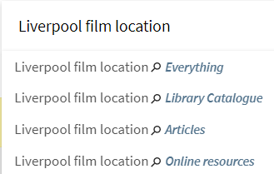
OneSearch landing page
Enter either a title, author or some key words into the text box
You can choose to search …
  Everything - both the library catalogue and online articles
  Just the Library catalogue
  Just online journal and newspaper Articles
  All online resources

Slide 4
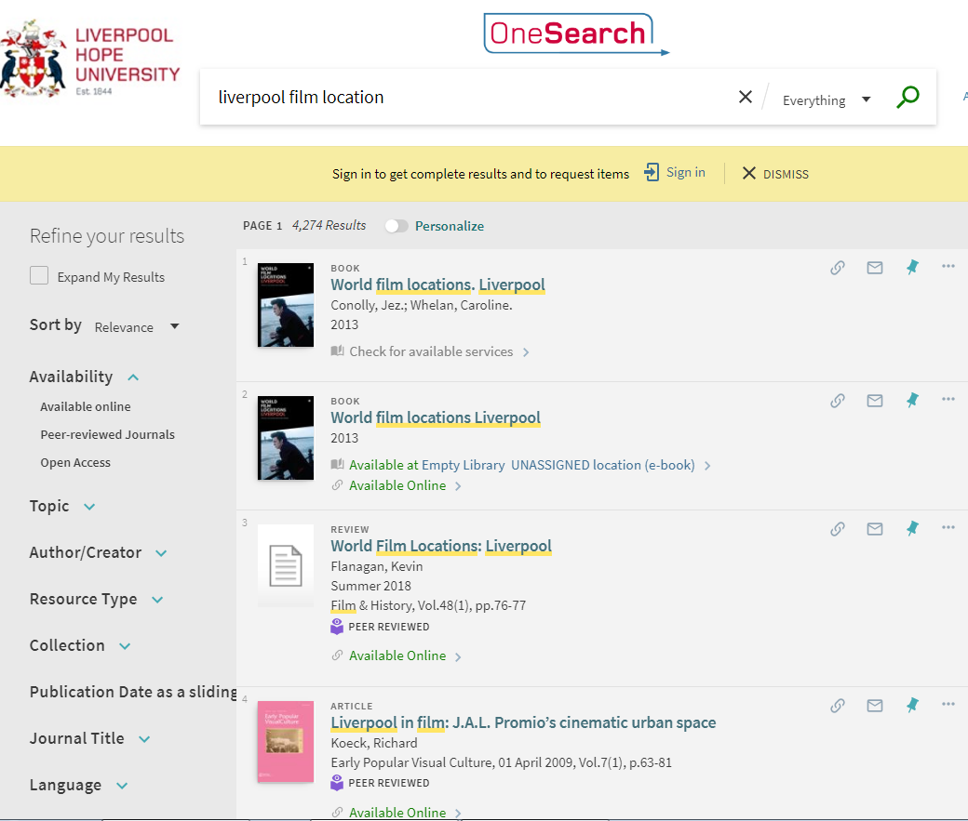
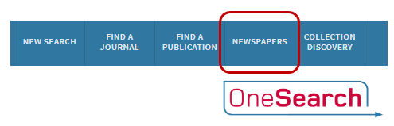
Results list
Results include print and electronic books and journal articles
For results from newspapers, scroll
to the top of the page and
select Newspapers

Slide 5
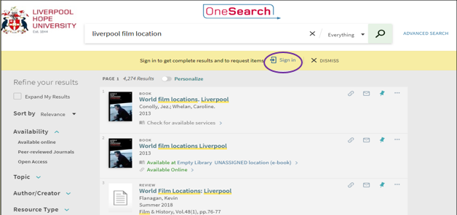
Accessing results
You must sign in if you want to:
view and link to everything for which you have full text access
save items to your favourites list

Slide 6
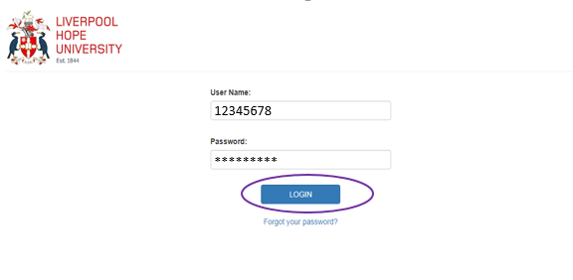
Sign in using your university username and password

Slide 7
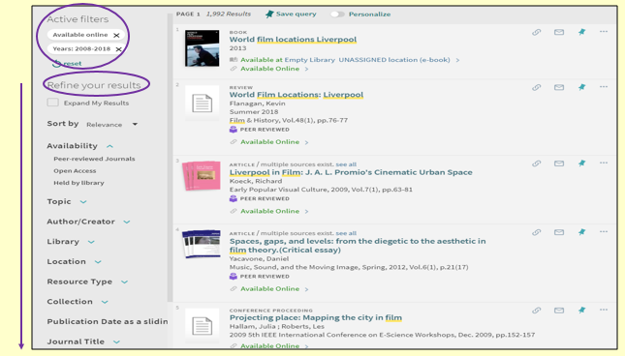
Ways to refine results from the results list
Results may be refined in different ways, such as Resource type or Language
In this case results have been refined by Publication date and to those Available online

Slide 8
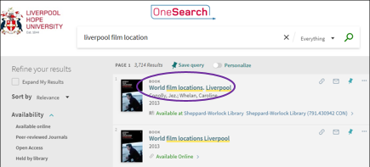
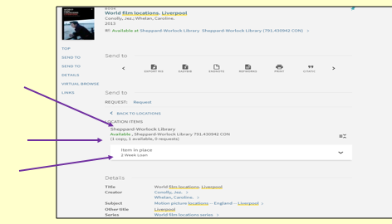
Viewing results: books
This book is available in both print and electronic format
For information about the print
copy click on the item title for
the full record
From the item full record you can see …
Where the book is located
If the book is available or on loan
How long the book may be borrowed

Slide 9
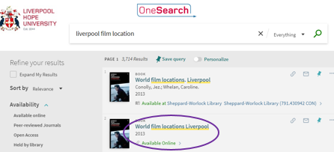
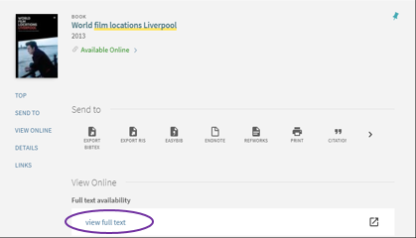
Viewing results: e-books
To view an e-book click on the item title
Then click on view full text
Remember – you must be signed in if you want to view the full text online

Slide 10
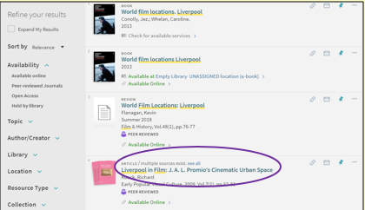
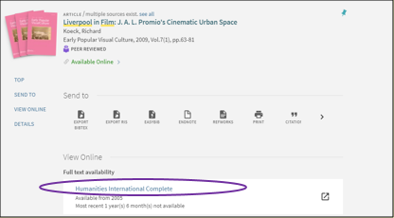
Viewing results: articles
To view the full text of an article select the article title
Then select the link, or one of the links, under View Online
Full text availability

Slide 11
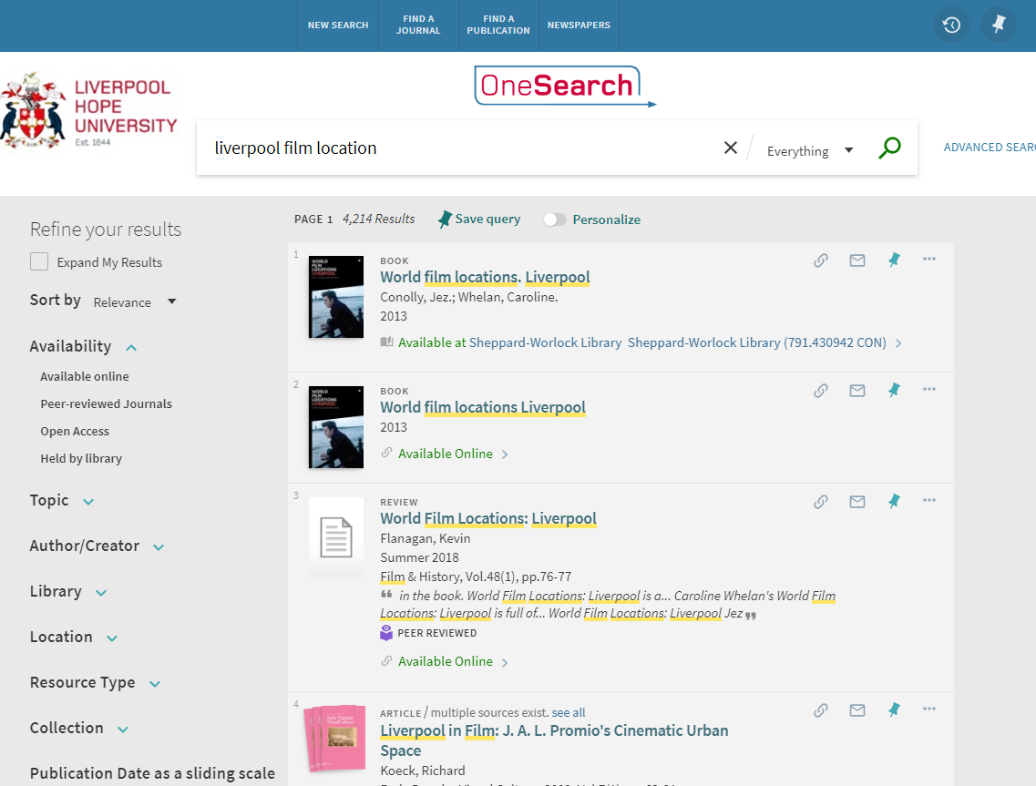
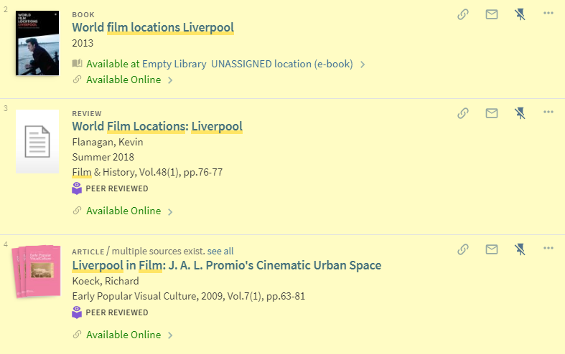

Saving results to your personal favourites list
Save results you want to keep to My Favourites by clicking on the Pin icon next to the item
To access My Favourites click on the Pin icon at the top right of the screen
Remember – you must be
signed in if you want to
save to or access My Favourites

Slide 12
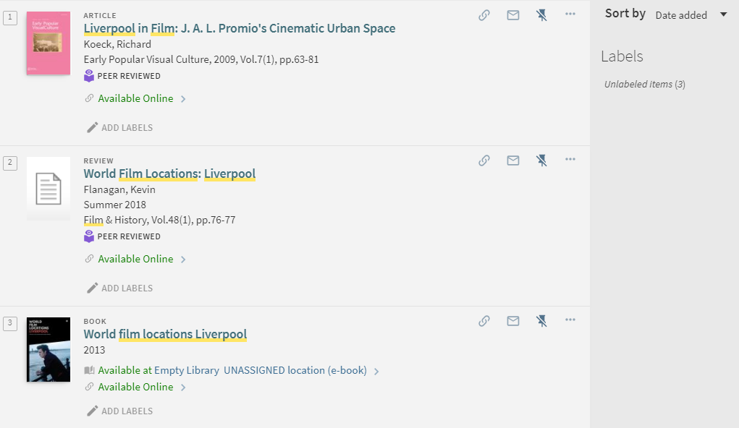
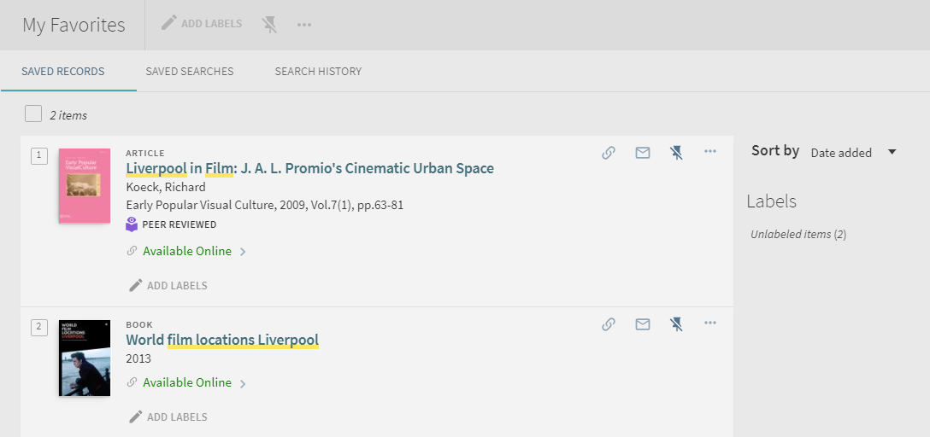
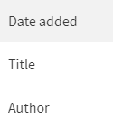

My Favourites list
In My Favourites, items can be sorted by date added, or alphabetically by title or author
Items can also be grouped together by selecting Add labels and entering a label title
You can delete an item from My Favourites by selecting crossed out Pin icon next to the item you wish to remove

Slide 13

Other features
From the top toolbar you can select …
New search – for the OneSearch landing page
Find a journal – to search for a specific journal title
Find a publication - to find a specific journal article, journal or book using citation information
Newspapers – to limit your search to newspapers only

Slide 14

Help and support
Ask us for help
  Library Help Point (0151 291 2000)
  Subject Support Points (0151 291 2079/2007)
or
Email/Chat: AskaLibrarian@hope.ac.uk
Twitter: @Hope_Library
Instagram: @LivHopeLibrary

